Slide 1



THE AFROVAS RESEARCH HOUSE.
RESEARCH PARTNERSHIP PROPOSAL
www.afrovasresearch.com

Slide 2



ABOUT US
THE AFROVAS RESEARCH HOUSE
Afrovas Research is an independent market research Organisation with HQs based in Nairobi, Kenya. Registered in 2014. We have teams and offices in strategic Angles of the continent that work seamlessly to deliver quality insights in a timely and efficient fashion.
We hold a myriad of skills and expertise that is the robust team of accredited research practitioners with cumulative decades of experience in the industry, an unbeatable local familiarity with the continent resulting in incomparable local intelligence and perspective.
www.afrovasresearch.com
Of Research Exellence

Slide 3


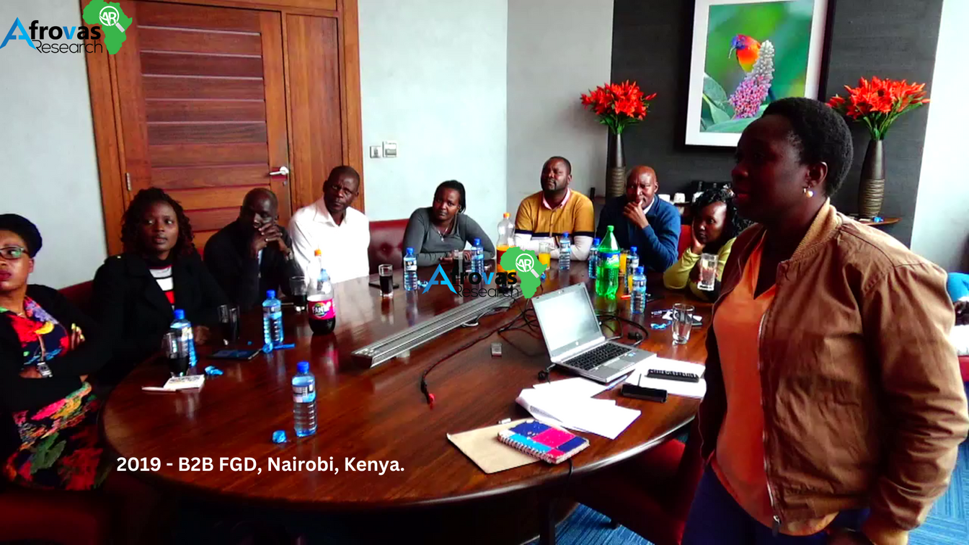
SERVICES
QUALITATIVE RESEARCH
We provide full-house qualitative solutions from recruitment and screening, incentive handling, moderation, venue network with two-way mirrors, note-taking, video and audio recordings, live streaming and verbatim transcription.
www.afrovasresearch.com

Slide 4


SERVICES
SURVEY FIELDWORK
We provide custom field support for various research methodologies and services in accordance with the vision & your teams’ goals.
4000+ TRAINED RESOURCES ACROSS AFRICA!
www.afrovasresearch.com
Of Research Exellence

Slide 5


SERVICES
ONLINE SURVEY PANELS
We have spent over a decade building and integrating various online panel communities globally with the capacity to complete thousands of surveys daily. Our panels are all hosted on a modular global system which is compatible with all major survey tools.
OVER 130 MILLION PANELISTS WORLDWIDE!
www.afrovasresearch.com

Slide 6




SERVICES
BRAND RESEARCH
CONSUMER SURVEYS
TELEPHONE SURVEYS
MYSTERY SHOPPING
  Brand Strategy Research
  Brand Identity
  Product Positioning
  Brand Loyalty
  Brand Management
  Brand Awareness Research
  Customer Satisfaction Measurement
  Customer Loyalty Research
  Customer Satisfaction Feedback
  Customer Surveys
  Voice of the Customer
  Computer-Assisted Telephone Interviewing (CATI)
  Qualitative Interviewing Research
  Telephone Survey Panels
  Mystery Shopping
  Telephone Mystery Shoppers
  Video Mystery Shopping
  Secret Shopper Network
  Store Audits
  Store Census
www.afrovasresearch.com
Of Research Exellence

Slide 7


WHY US?
Of Research Exellence
Right Values
Right Position
Right Budget
Right on Time
Afrovas is committed to truth, accuracy and objectivity in proposing, designing, performing, evaluating and reporting of research. We tell it as it is so you make decisions from a well informed position.
We train, and build an extensive network of experienced native field operators in every market we operate. We thus provide a single roof command center for running field operations to including the most isolated parts of the Sub-Saharan Africa.
We work directly with our teams on the ground to ensure we avoid marginal layers which enables our partners to get the true bare cost of working in Africa. With us you will realise that Africa is the most affordable region in the world, and that applies to its quality research too.
We believe that all research has a time-specific purpose.For this reason we go out of the comfort zone to the very limits and ensure that data is availed as soon as requested. Yes we do Overnight Qual too.

Slide 8

OUR NUMBERS
  3M+
  120M+
  4,400+
  1,692
  10
Africans Interviewed
Panelists Wordlwide
Projects Delivered
Happy Clients
Years of Research Excellence
www.afrovasresearch.com
Of Research Exellence

Slide 9
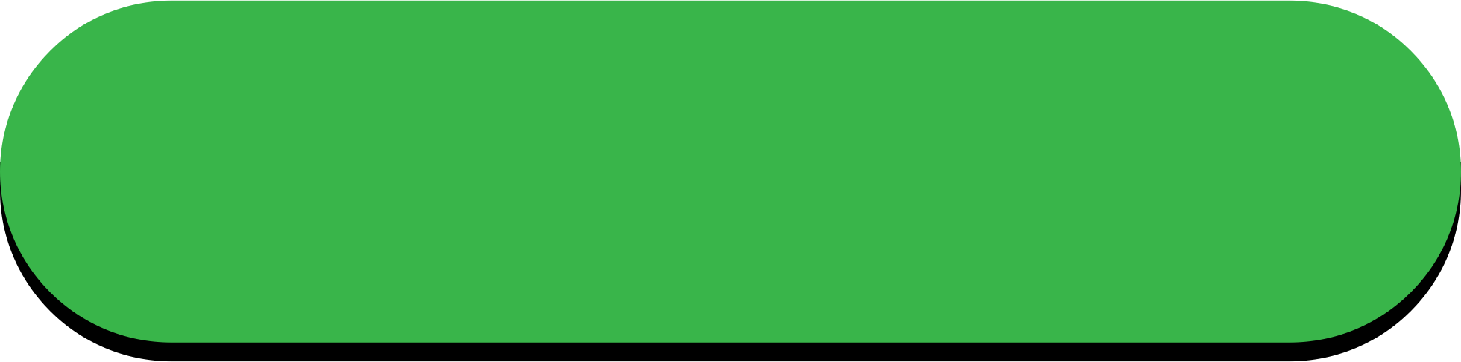
OUR COVERAGE
WEST AFRICA
EAST AFRICA
CENTRAL AFRICA
NORTH AFRICA
SOUTH AFRICA
  Benin.
  Burkina Faso.
  Cape Verde.
  Gambia.
  Ghana.
  Guinea.
  Guinea-Bissau.
  Liberia.
  Mali.
  Mauritania.
  Niger.
  Nigeria.
  Senegal.
  Sierra Leone.
  Togo.
  Burundi.
  Comoros.
  Djibouti.
  Eritrea.
  Ethiopia.
  Kenya.
  Madagascar.
  Malawi.
  Mauritius.
  Mozambique.
  Rwanda.
  Seychelles.
  Somalia.
  South Sudan.
  Tanzania.
  Uganda.
  Angola.
  Cameroon.
  Central African Republic.
  Chad.
  Democratic Republic of the Congo.
  Equatorial Guinea.
  Gabon.
  Republic of the Congo.
  Sao Tome and Principe.
  Algeria.
  Egypt.
  Libya.
  Morocco.
  Sudan.
  Tunisia.
  Botswana.
  Lesotho.
  Namibia.
  South Africa.
  Swaziland.
  Zambia.
  Zimbabwe.
Our 150+ Countries Global Online Reach
www.afrovasresearch.com
Download Panel Book

Slide 10












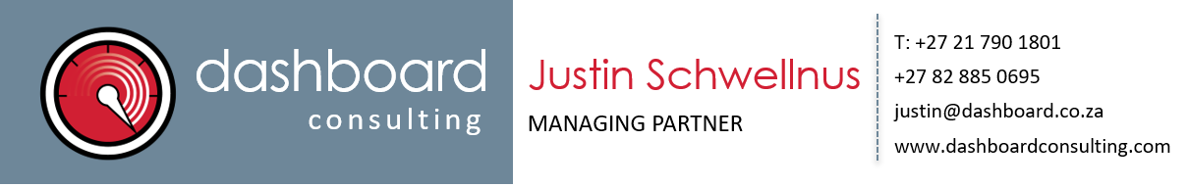


TRUSTED BY
Some of the partners we’ve collaborated with.

Slide 11


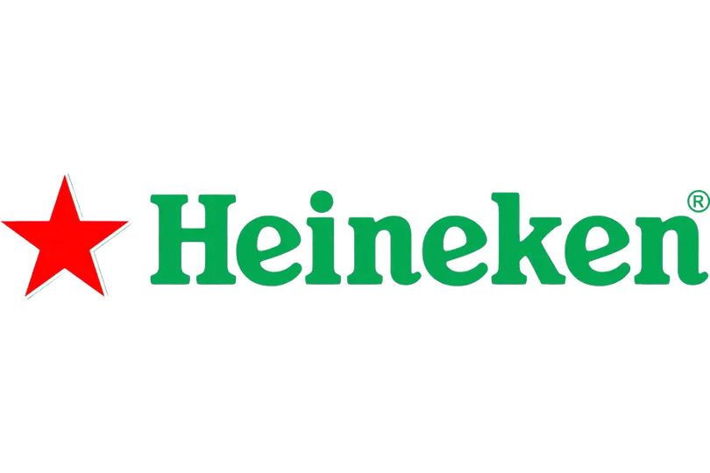










BRANDS
Few of the brands we’ve collaborated on.

Slide 12

Afrovas is a client focused outfit, which endeavours to be a leading business organisation in the field of market research data collection, satisfying its clients with on-time high quality delivery of data and reports based on authenticated data collected by its Field Operations teams and subsequently processed by its Data Processing arm.
The data collection process at Afrovas is based on processes that ensure that we speak to the right Respondents, in the right manner, and collect authentic and valid consumer responses. There are checks and balances in place at every stage of the data collection and data processing process so as to identify and isolate any human errors. Any non-conformity are addressed as per laid out procedures, with the aim to provide the highest quality data to the Client Service team, based on which they can deliver actionable insights to clients.
All details related to fieldwork and data processing are properly documented and preserved as per the relevant ESOMAR standards. Afrovas has a trained and qualified Management Representatives who head the internal team of professionally trained Internal Quality Field managers and Auditors.
QUALITY
STATEMENT
Afrovas’ vision and mission statements drive business success by motivating and providing clear direction to employees, and ensuring that we work ethically with external suppliers as well as clients, resulting in to high customer satisfaction and retention.
Afrovas conducts its research based on utmost confidence for its customers and the reports are not made available to third parties without their express authority and consent and are stored securely in a proper and safe manner. Afrovas functions based on the framework of legal requirements of the countries in which it operates. Afrovas also aims to reduce its environmental footprint to make it a sustainable growing organization.
Afrovas has strict internal quality audits which are done minimum 2 times a year. In case of major non-conformities further investigation is conducted via root cause analysis to ensure that the issue is permanently resolved. Afrovas aims to have as few customer complaints as possible and in case any disputes do arise, they are resolved in the best interests of both the parties and with the commitment to quality and fair business practices.
Afrovas initiates a program of continuous improvement in its key processes which are evidenced in its objectives and targets which are monitored and reviewed on monthly basis and carried out by its peoples under the guidance of the Top Management.

Slide 13






CONTACT US
Phone
+254 700 181 354
Email
research@afrovasresearch.com
Website
www.afrovasresearch.com
Location
PRR2+878, Karuna Rd, Nairobi, Kenya

